Slide 1
Notes:
Open the websites
Ready Vim’s example file.

Slide 2
LaTeX + Vim = Vimtex
By Taper
Notes:
Self Introduction
My Personal Style

Slide 3
I love being
Simple
Practical
Notes:
Problems: They Great, Powerful, But Learn a lot, time.
That is a mis-concept
NO I teach simple

Slide 4
Motivation
Time is short
Why LaTeX, Why Vim
Notes:
L Mention only

Slide 5
Easy
Appropriate Usage
free Templates(模版)
Filling the Blanks
Notes:
Based on assumption.
A simple PPT v.s. Scholarly presentation (that requires a lot of math)
Fill in the blanks, complete diff from word.

Slide 6
Focus on Writing
Separate Content & Display
Separate Writing & Design
Font
Size
Color
Notes:
Latex separate content and display
Open latex file to show it
Avoid paying attentions to …
Let LaTeX templates to deal with it.

Slide 7
01100010100101010100101010100101011000
Digitalization
Notes:
My second Aim

Slide 8
Digitalization
Notes
C.V.
Undergraduate Thesis
Notes:
Serious attempt

Slide 9
Digitalization
Online Q&A
Math Overflow
Physics Overflow
Notes:
Encourage use ONLINE QA
Need Math , then need Latex
Give two examples (open website)
2 fold benefit of Online QA:
1. more people know 2. useful for others 3. have some doubts find online

Slide 10
Digitalization
Digital Tools
Notes:
Github …
Search …
PKM …
Don’t Spend much Time here.

Slide 11
Personal Aim
Collaboration & Cooperation
Notes:
Found online notes to be helpful
You have been Missing
Your own notes helpful -> friends
Similar background, similar interests
WYH Hessian matrix,

Slide 12
Collaboration & Cooperation
Yours are helpful
Notes:
3rd Personal Aim
Found online notes to be helpful
Your own notes helpful -> friends
1. Ask you in person
2. Similar background, similar interests
WYH Hessian matrix, KeWang TopoClassification

Slide 13
Collaboration & Cooperation
Don’t be Alone
Notes:
独狼
Personal experience alone not good
Personal experience I don’t talk much, I love digits, Kill two birds with one stone. 一石二鸟
Push you share notes
KeWang K-Theory Note.

Slide 14
Collaboration & Cooperation
Notes
Blogs
Notes:
Serious attempt

Slide 15
Alignment
\begin{align}
i \frac{\partial}{\partial t} \ket{\Psi_I(t)}
=& i \frac{\partial}{\partial t} (e^{i\hat{H}_0t} \ket{\Psi_S(t)}) \\
=& i (i\hat{H}_0)
\cdot \ket{\Psi_I(t)} + e^{i\hat{H}_0t}
\cdot \frac{\partial}{\partial t} \ket{\Psi_S(t)} \\
=& -\hat{H}_0 \ket{\Psi_I(t)} + e^{i\hat{H}_0t} (H_0+V) \ket{\Psi_S(t)} \\
=& [-\hat{H}_0 + e^{iH_0t} (\hat{H}_0 +V) e^{-i\hat{H}_0t}] \ket{\Psi_I(t)} \\
\label{eq:motion}
=& \hat{V}_I \ket{\Psi_I(t)}
\end{align}

Slide 16
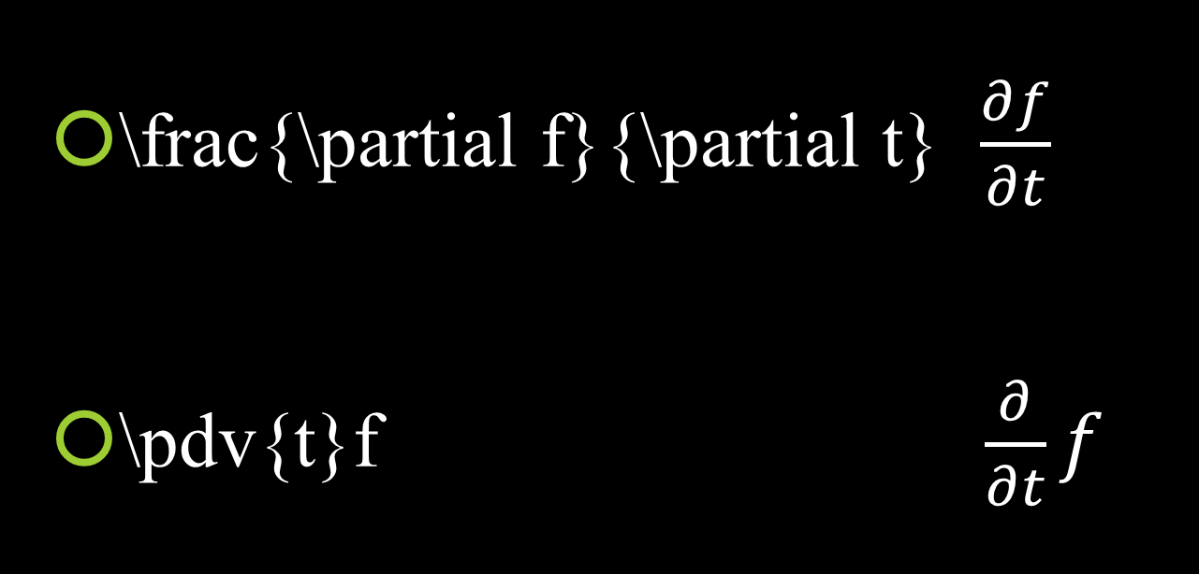
Readable Command
\frac{\partial f}{\partial t} $\frac{∂f}{∂t}$
\pdv{t}f $\frac{∂}{∂t}f$

Slide 17
Vim
Notes:
Snippets (iff, st, wrt, 1/2, pt, item, templates)
Save -> Folding, equation, Autocomplete (this is SUSTech, \cite, )
Compile,

Slide 18
Vim
Less Repetition
Notes:
2 thing: fewer keybrd2mouse, fewer repeat-key-hitting.

Slide 19
Vim is almost Everywhere
Eclipse IDE, Sublime Text, Visual Studio
Notepad++
Chrome, Firefox
Mac/Linux (Unix)
…
Notes:
Almost everywhere

Slide 20
Alternatives
GNU Emacs
LyX
GNU TeXmacs
……

Slide 21
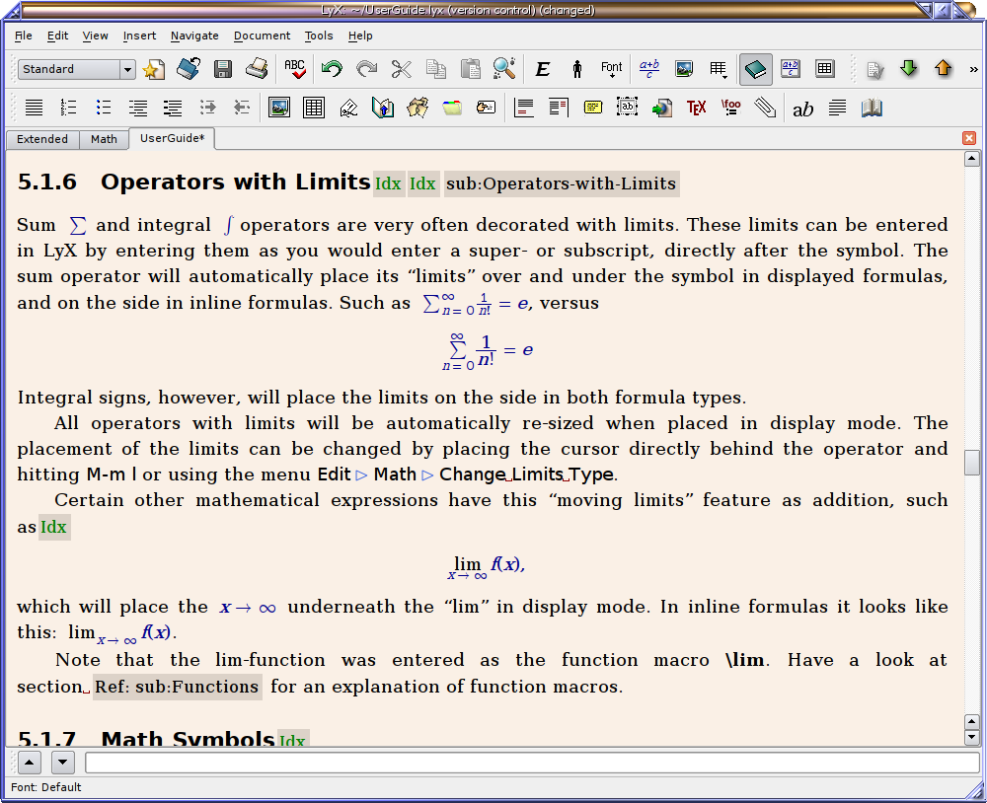
LyX
翁文康
Notes:
Picture credit: http://tex.stackexchange.com/questions/339/latex-editors-ides

Slide 22
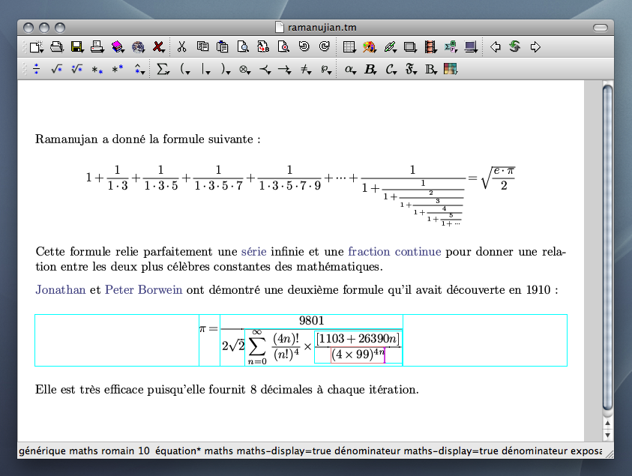
TeXmacs
孟斐
Notes:
Picture credit: http://www.texmacs.org/tmweb/home/screenshots.en.html

Slide 23
WhatYouSeeIsWhatYouGet
LyX
GNU TeXmacs
NOT Distraction-free

Slide 24
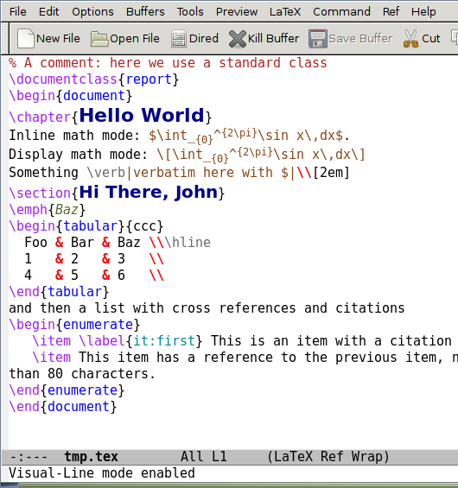
GNU Emacs
江帆
Notes:
Actually suggest trying out
Also very famous in programmer’s world
Picture credit: http://tex.stackexchange.com/questions/339/latex-editors-ides

Slide 25
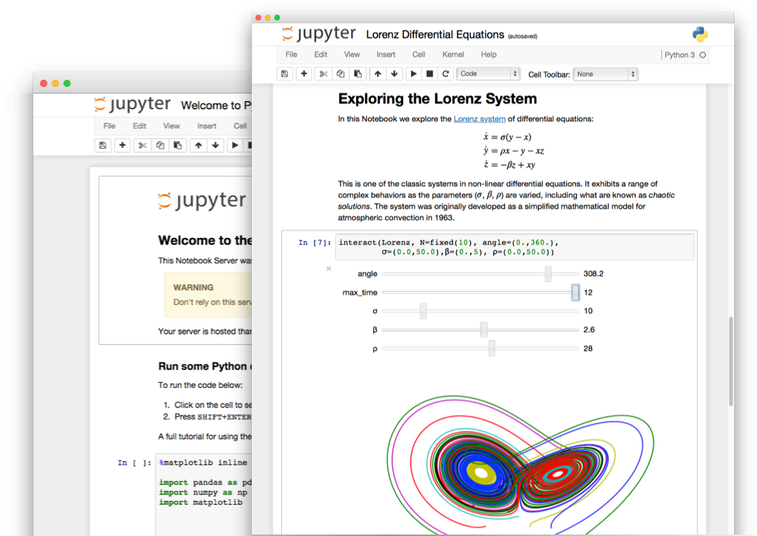
Jupyter
陈伟强
Notes:
X rule out
Vim v.s. Emacs
Picture credit: http://jupyter.org/

Slide 26
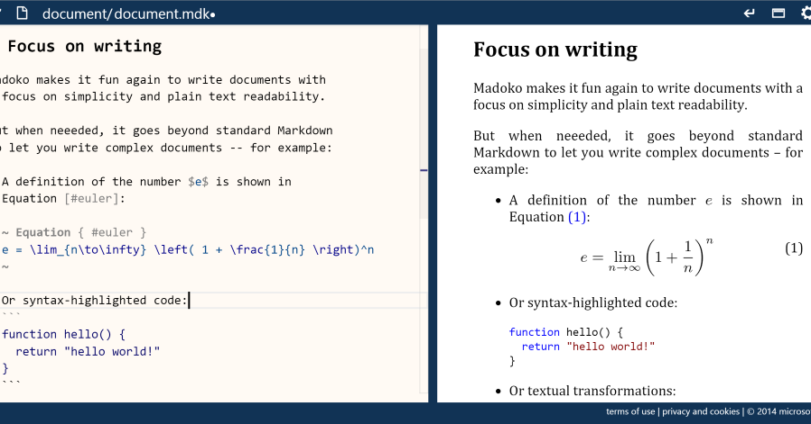
Madoko
Beta
Notes:
Picture credit: https://www.madoko.net/

Slide 27




Schedule
Motivation & Intro 😝
Install Vimtex ☹
Basics of Vim & Latex 😄
Tips and Pitfalls 😍

Slide 28

2. Install Vimtex
Install LaTeX
Install Git
Install Python
Install TeX Studio, Mathematica
Install Vim, TeX Studio
Install Plugins for Vim
Vimtex
Ultisnips
Neocomplete
…
Notes:
Why you should learn with me?
Hardest part, Me 2 weeks, like Landau Potential
Hardest time, prone error
Mac, try my best

Slide 29

3. Foundation
Markdown
Vim Gymnastics
LaTeX 123
Using Google, and Internet
Notes:
Exercising your fingers
How I see my work: No Spoon-feeding
Foundations 粉底

Slide 30

4. Flexible
Tips & Pitfalls
Tips on Vim Editing
Useful Packages
for Mathematicians & Physicist
Case based
Notes:
Many more,
Tips, useful packages.
Haven’t prepared yet. What do you want to do?

Slide 31
Take Home
Vimulator (Vim-simulator)
Vrapper (Eclipse Market)
Firefox (Vimperator, VimFx)
Sublime
Atom
http://www.vimgolf.com/

Slide 32

Q & A
Notes:
Ask here
I X talk a lot

Slide 33
Mathematics
\begin{align}
i \frac{\partial}{\partial t} \ket{\Psi_I(t)} =& i \frac{\partial}{\partial t} (e^{i\hat{H}_0t} \ket{\Psi_S(t)}) \\ =& i (i\hat{H}_0)\cdot \ket{\Psi_I(t)} + e^{i\hat{H}_0t} \cdot \frac{\partial}{\partial t} \ket{\Psi_S(t)} \\ =& -\hat{H}_0 \ket{\Psi_I(t)} + e^{i\hat{H}_0t} (H_0+V) \ket{\Psi_S(t)} \\ =& [-\hat{H}_0 + e^{iH_0t} (\hat{H}_0 +V) e^{-i\hat{H}_0t}] \ket{\Psi_I(t)} \\
\label{eq:motion} =& \hat{V}_I \ket{\Psi_I(t)}
\end{align}
Notes:
Contradict

Slide 34
WORDs > NUMBERs
Less equations
More words
Notes:
In fact, your found in …
Why is that
Expressive, Deep, intuition.

Slide 35
Recommended Reading
Notes:
Find more about this topic
1st chapter

Slide 36
WORDs > NUMBERs
“Many graduate-school advisors have noted that an applicant for a mathematics fellowship with a high score on the verbal part of the GRE is a better bet as a Ph.D. candidate than one who did well on the quantitative part but badly on the verbal. ”
---- Paul. R. Halmos
Notes:
Quote

Slide 37
This morning…
Notes:
vim对中文不友好
Emacs and Vim are just ….

Slide 38
Take Home
https://vim-adventures.com/
http://physics.stackexchange.com/
https://physicsoverflow.org/
http://math.stackexchange.com/
http://mathoverflow.net/?tab=featured
https://www.biostars.org/
http://tex.stackexchange.com/questions/339/latex-editors-ides
https://www.sharelatex.com/templates
https://www.sharelatex.com/project/58ce64e6f98f21f60fedc9af
https://www.overleaf.com/latex/templates
https://ncatlab.org/nlab/show/HomePage
Notes:
don’t try install vim yourself
Just play the games
干货

Slide 39
Take Home
Register a website you feel interested.
Try a LaTeX template.
Play Vim Adventure (level 1~3).
See my GitHub: https://github.com/we-taper/Draft
Notes:
干货

Slide 40
End
À bientôt!

